Slide 1
Directions of Smart Agriculture Policy
in Korea

Slide 2

Contents
ㅑ
Current State of Korean Agriculture
Ⅰ
Ⅱ
Needs for Smart Agriculture
Ⅲ
Details on Progress
Ⅳ
Directions of Smart Agriculture Policy

Slide 3
Ⅰ. Current State of Korean Agriculture
Decreased agroforestry proportion in GDP
Deepening income gap between urban and rural areas
Agroforestry Output and Proportion in GDP
Farm Household Income & Agricultural Income
GDP Proportion
( Million KRW )
Proportion
Urban Worker’s Household Income
(59 Million)
80%
5.4%
60
2.9%
75%
1.9%
50
Farm Household Income
(37 Million)
70%
Agroforestry Output
40
(Unit: Trillion KRW)
65%
30
50
Agricultural Income
(10 Million)
60%
20
55%
30
27.3
36.3
50.6
10
50%
10
2005
2008
2011
2014
2017
1995
2005
2017
Agroforestry Proportion in GDP
(‘95) 5.4% → (’17) 1.9%
Ratio of Agricultural Income to Urban Worker’s Income
: (‘05) 76.4% → (’17) 63.5%

Slide 4

Ⅰ. Current State of Korean Agriculture
Decrease and rapid aging in farming population
Shortage of young farmers
Changes in Farm Population
Ages of Farm Owner (‘17)
( 세 )
Men in 2015
100
F
Female in 2015
90
M
Men in 2000
Female in 2000
40~65 years
40.9%
Under 40 years
0.9%
80
70
60
50
40
30
20
65 years or older
58.2%
10
0
50
40
30
20
10
0
10
20
30
40
50
( Unit: Thousand persons )
Farm population : (‘00) 4.03 Million → (’15) 2.57 Million → (’17) 2.42 Million

Slide 5
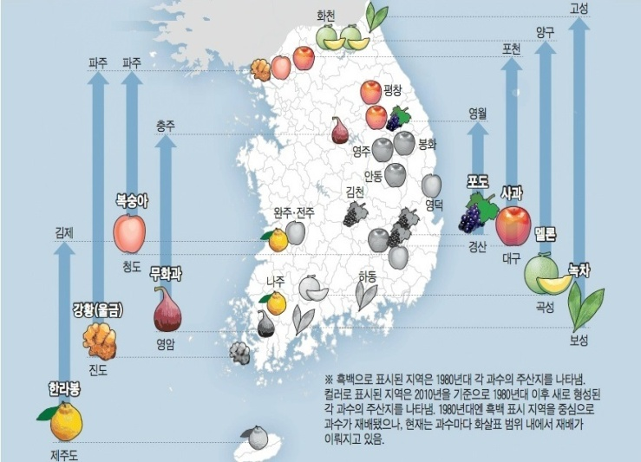
Ⅰ. Current State of Korean Agriculture
Climate Change
Temperature Rise by 2050
Changes in Plantation Map in Korea
3.4 ℃
2.3 ℃
Korea
Global

Slide 6
Ⅱ. Needs for Smart Agriculture
What is Smart Agriculture?
Called digital agriculture, data agriculture or precision agriculture, etc. in other countries
Generally, it means using a data-based ICT convergence technology in the entire agricultural cycle from production to distribution and consumption
What is Smart Farm?
Means a farm that uses ICT technologies to the protected horticulture, fruit, livestock and crop farming to maintain and manage proper growth conditions through remote or automated control

Slide 7
Ⅱ. Needs for Smart Agriculture
① Improved Productivity
Optimal growth conditions Reduction of inputs and labor Improved productivity (40% increase in per capita production, SNU)
Optimizing
growth conditions
Precise and
Automated control
Farms Adopted Smart Farming (%)
Collecting environment and
growth information
Labor Cost
Pest & Disease
Temperature, humidity, CO2
growth speed
Big data analysis
Growth management S/W
CO2, nutrients and feed supply
A/C and heating operation
Window operation
27.9
40.4
-15.9
-53.7
Yield
Yield
per person
② Response to Climate Change
In terms of protected horticulture , active response to climate change is possible through environment control.

Slide 8


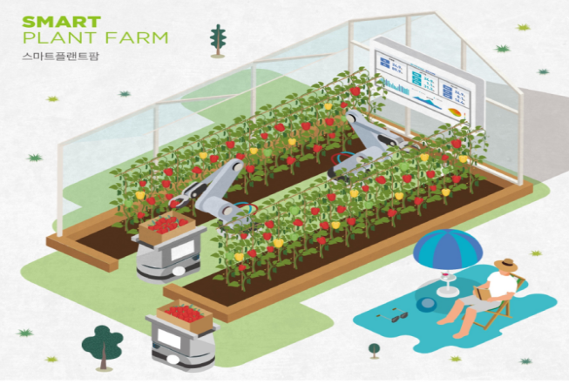
Ⅱ. Needs for Smart Agriculture
③ Attracting Young Farmers
Voices from the field
Use of ICT technology and data enables scientific farming and young farmers are more attracted to enter farming business as they can remotely control the farm operation with their mobile phone.
“Upfront investment is burdensome in terms of automation and cutting-edge facilities and it is difficult to learn how to operate and maintain.”
Farmers
Youth
((Returned/Startups)
“We’re concerned if we can do it well as we don’t have professional agricultural knowledge, technology nor knowhow.”
④ Environment-friendly
Benefits include reduction in peat and disease outbreaks and unnecessary supply of nutrients as well as reduced environmental burden through odor control.

Slide 9
Ⅲ. Progress in Smart Farming
Spread of Smart Farm
Policy support to spread Smart Farm has increased since 2014
- (Protected horticulture) By linking to facility modernization project, supplying ICT equipment, building smart greenhouses, and establishing a smart horticulture
<Status of Smart Farms>
Classification (Cummulative) | Before 2013 | 2014 | ‘2015 | ‘2016 | 2017 | 2018 | 2019(p) | 2022 target
Facility horticulture | 345ha | 405 | 769 | 1,912 | 4,010 | 4,900 | 5,017 | 7,000
Livestock | - | 23호 | 181 | 430 | 801 | 1,425 | 2,150 | 5,750

Slide 10
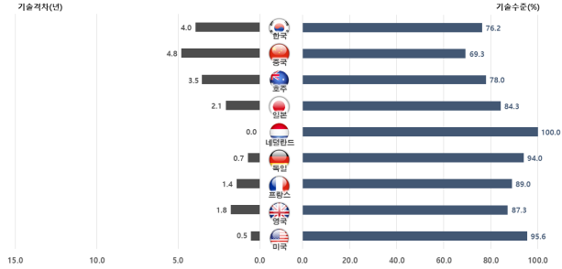
Progress in Smart Farming
Smart Farm R&D
Standardization and localization of ICT equipment and development of growth control technology by item are key R&D tasks.
’18
’19
’20
’21
10 Key Factor Technology: Average Technology Gap 4.0 years, Technology level 76.2%
(부)첨단생산기술개발
* ‘19년부터 스마트팜 관련
신규과제 지원중단
(과)
SFS 융합연구단
(청)
한국형스마트팜
핵심기반기술개발
(청)
첨단기술 융복합
스마트팜 기술개발

Slide 11
Ⅳ. Directions of Smart Agriculture Policy
1. Smart Farm Innovation Valley
Production Complex
Youth Startup
Demonstration Complex
Smart technology application to aged facility and system integration
Synergy by linking processing, distribution, and export
Education and business management training
Leased Smart Farm (6ha per farm)
Youth startup and employment
Equipment demonstration and big data analysis
Business R&D matching research support
Approval certificate, exhibition experience service 1
Local Specialization
Identifying an innovation valley model suitable for local characteristics (Ex: export hub, bioindustry hub)
+
Inducing participation and investment from agricultural corporations and businesses
Smart Farm Innovation Valley (4 places) : Gimje (Jeonbuk), Sangju (Gyeongbuk), Goheung (Jeonnam), and Miryang (Gyeongnam)

Slide 12


Ⅳ. Directions of Smart Agriculture Policy
2. Promoting R&D Specialized in Smart Farm
Project Detail
Strategic Tasks
Performance Objective
1
1. High productivity digital cultivation technology
Smart Farm Demonstration and Advanced R&D Project
Commercialization of smart farm solution customized to site considering characteristics of local, production scale, item, etc.
2. Optimized field-specific smart farm technology
3. Highly-productive and precise livestock management technology
4. Intelligent environmental control technology for livestock shed
5. Optimized smart livestock model (K-FARM)
6. Fully autonomous integrated control platform for smart greenhouse
2
Next Gen Convergence and Source Technology R&D Project
7. Unmanned and automation production cycle management technology for greenhouse
Leading global smart farm technology by developing state-of-the-art intelligent information convergence and source technology
8. Technology for full circulation and use of green energy
9. Integrated solution for K-FARM for unmanned autonomous smart livestock farming
10. Full energy and resource circulation model for livestock farming

Slide 13
Ⅳ. Directions of Smart Agriculture Policy
2. Promoting R&D Specialized in Smart Farm
Supporting packages linking policy and project
Leading global technology completing existing performance
Chemical integration among Ministries

Slide 14

Ⅳ. Directions of Smart Agriculture Policy
2. Promoting R&D Specialized in Smart Farm
Spread of Smart Farm and Growth in Relevant Industries
System Improvement
Preparing for deregulation for establishing smart farm and relevant standards (draft)
Manpower Development
Fostering experts in technology and big data, and training farmers on smart farm
Diffusion Project
Consulting on modernization of horticulture and livestock sheds and diffusion of smart farm
Commercialization
Demonstration
Smart Farm
Innovation Valley
Livestock ICT
Model Complex
Developing innovative technology of multi-ministerial package for smart farm
Technology Development
Linking infrastructure construction to R&D projects

Slide 15
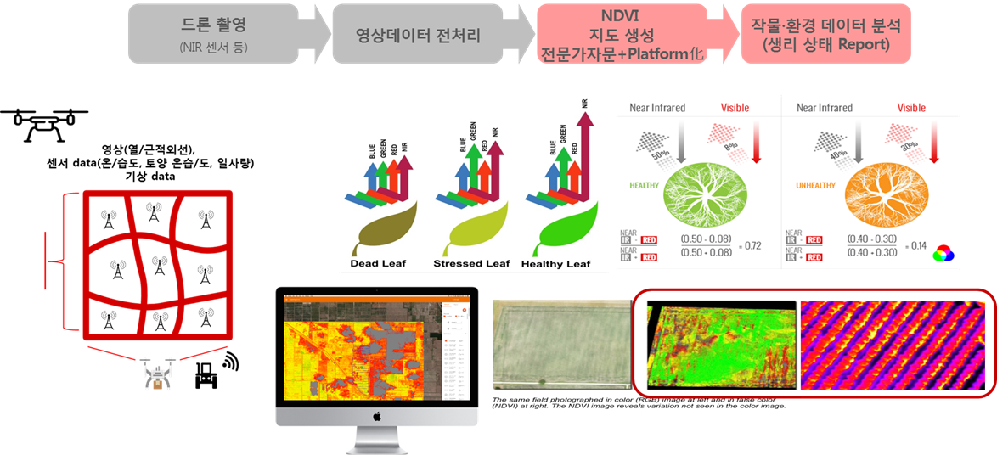
Ⅳ. Directions of Smart Agriculture Policy
3. Developing Smart Model for Outdoor Farming
Applying the Internet of Things (IoT) and farming machinery to farm complexes to collect and use data on weather, crop conditions, farming activities
Concentrate supply of demonstrable technologies and equipment to the two sites growing outdoor crops
Growth state and yield of outdoor crops using drone spectrum analysis

Slide 16
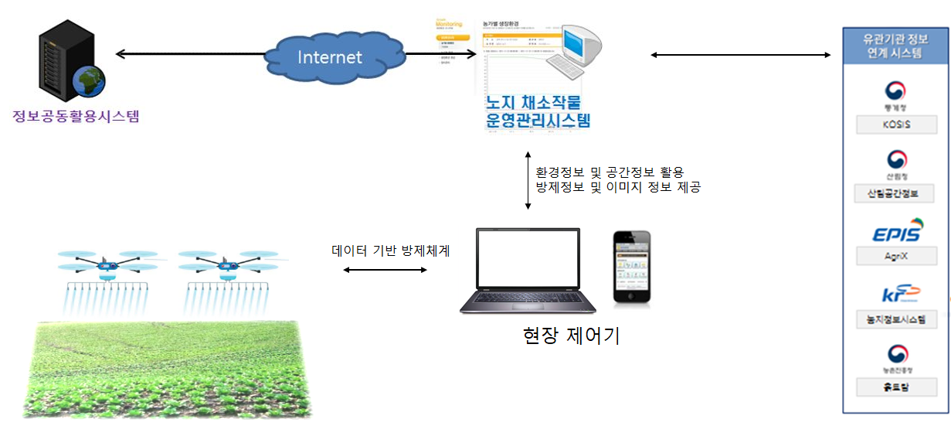
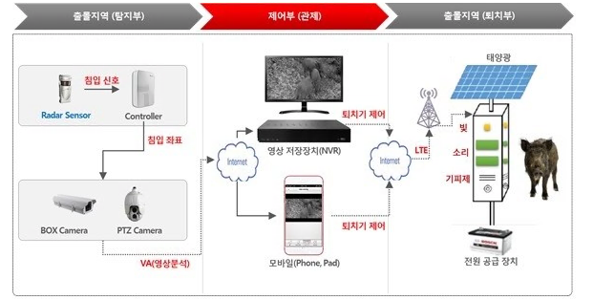
Ⅳ. Directions of Smart Agriculture Policy
3. Developing Smart Model for Outdoor Farming
Wild animal control through video analysis
Prediction of pest and disease, and smart crop dusting
using small unmanned helicopter or drone

Slide 17
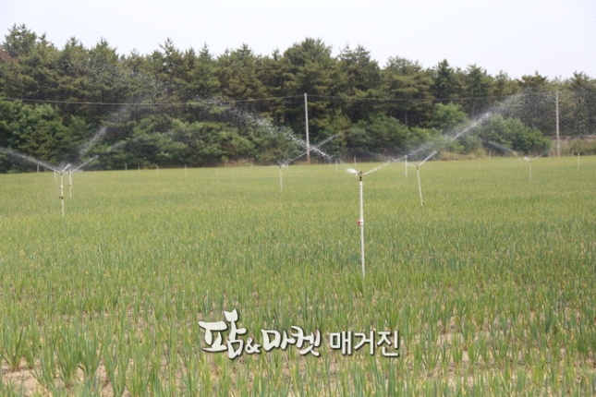
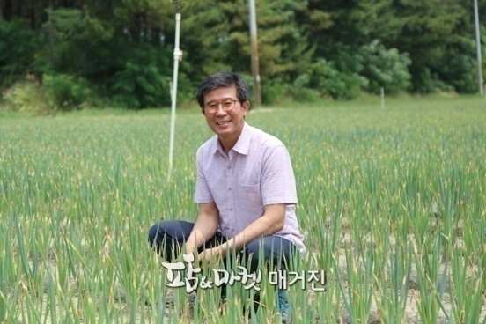
Ⅳ. Directions of Smart Agriculture Policy
3. Developing Smart Model for Outdoor Farming
Exemplary case of turning outdoor farming to smart farming: Kim Gwang-su (President of Sinan Agriculture and Information)
“In the past, I couldn’t sleep well because I had to irrigate the wide green onion field. Now, however, I can sleep tight, and even can do other things. Smart farm sets me free. Practicing smart farming improved my quality of life.”

Slide 18
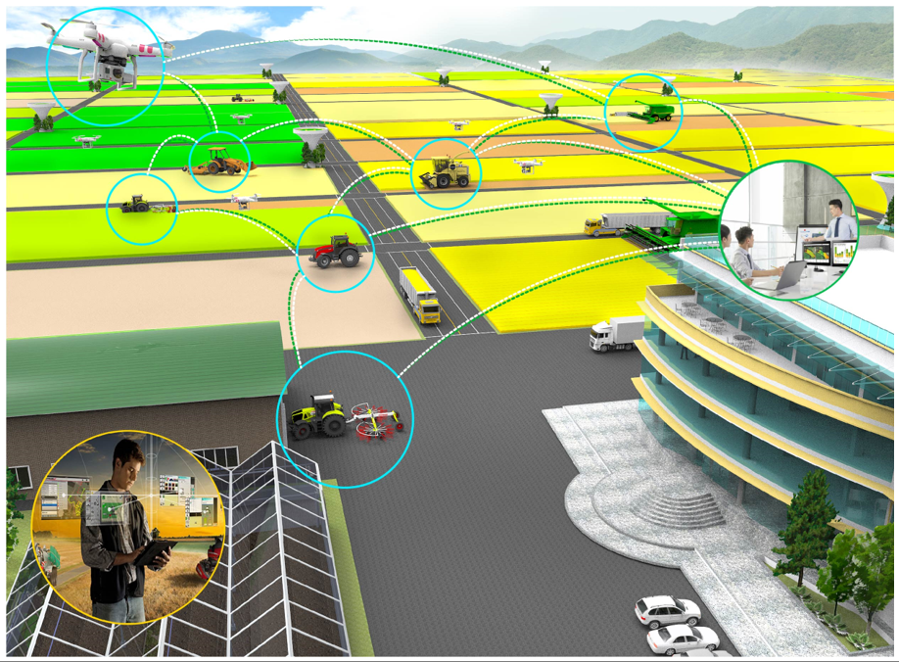
Ⅳ. Directions of Smart Agriculture Policy
4. Developing Cutting-edge Agricultural Machinery
All the farming activities are done with unmanned automated agricultural machine while men monitor and control the machinery at an integrated control center
R&D support is being provided to help commercialize autonomous tractor and rice-planting machine by 2021
Building an agricultural production system with cutting-edge agricultural mechanization, and deploying it to large farming zones

Slide 19
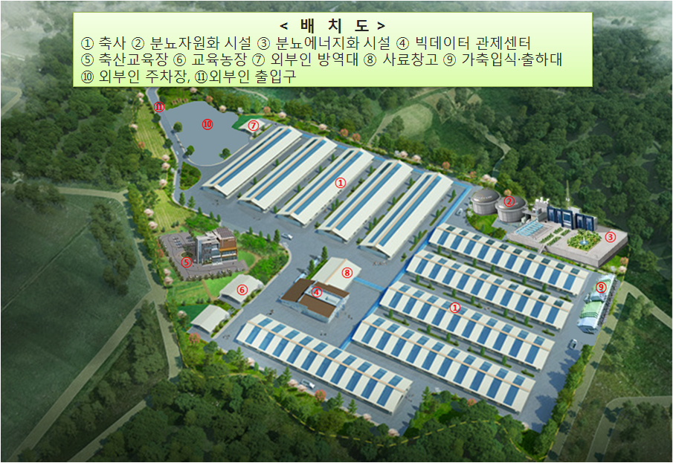
Ⅳ. Directions of Smart Agriculture Policy
5. Livestock ICT Pilot Complex
Reduce constraints of existing livestock business and create optimal feeding environment by converging high-tech facility and equipment with ICT (big data, IoT, etc.).
Installed state-of-the-art production and stink reduction facilities, common excreta treatment and quarantine & disinfection facilities, and hands-on training center
축산 ICT 시범단지
Pilot Complex in2019
Uljin, Gyeongbuk (Korean native cattle), Gangneung, Gangwon (Pig), Dangjin, Chungnam (dairy cow)

Slide 20
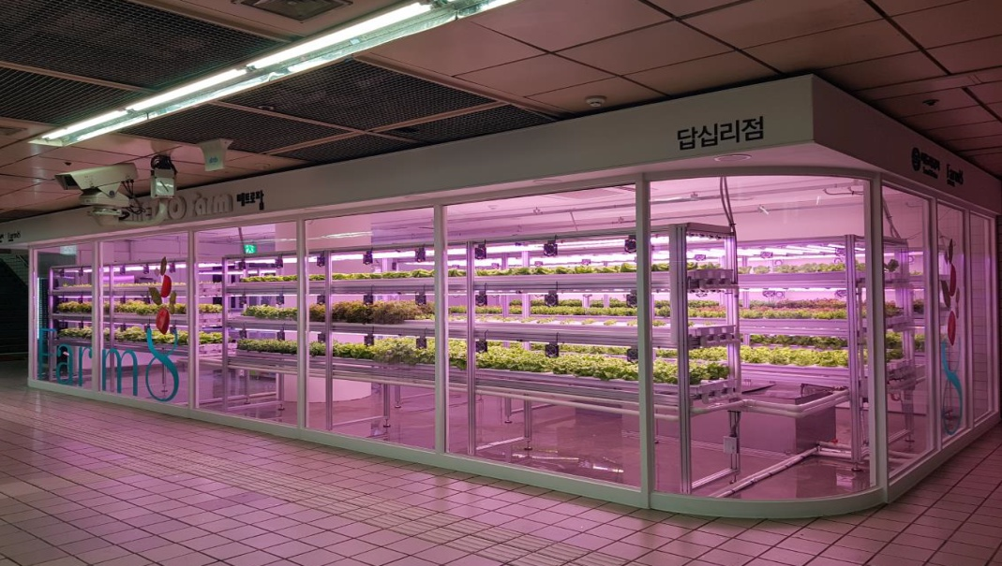
Ⅳ. Directions of Smart Agriculture Policy
6. Plant Factory
In partnership with Rural Development Administration, a closed-type vertical farm (plant factory) project has been promoted so that businesses, research institutions, and agricultural corporations can form a consortium to produce value-added crops.
Full view of a plant factory installed at Dapsimni Subway Station

Slide 21

Thank You!

